Slide 1
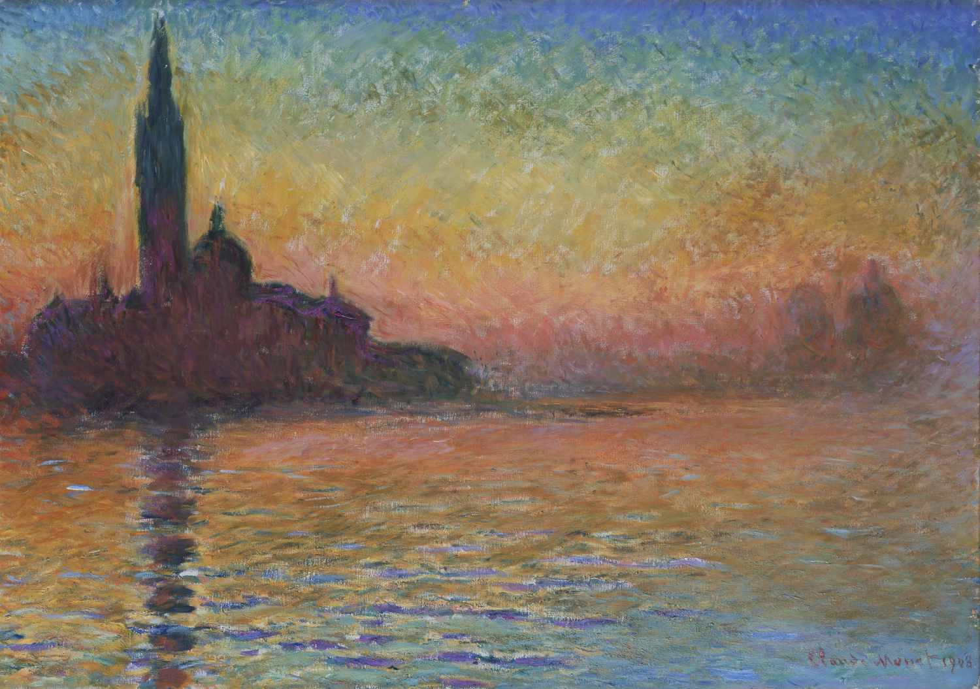
Impressionist Music
Benson Cheung
2023

Slide 2
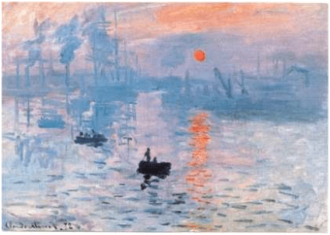
What is Impressionist Music?
Mood and Atmosphere
Tone Colour
Progressive harmonic concepts
Fluidity
Notes:
A style that explores mood and atmosphere through the use of timbre, orchestration, and progressive harmonic concepts
fluidity (the lack of a strong rhythmic pulse), atmosphere (how music feels and sounds), and tone color
Start around 20 century, influence by France
Progressive Harmonic concepts
Fluidity

Slide 3
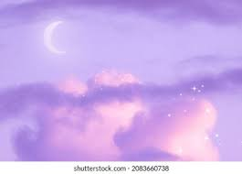
Why am I interested in Impressionist Music?
Dreamy sound
Good way to express emotion
Learn more how to compose different type of music
Notes:
Beautiful dreamy sound, love there songs which is so imaginable by just listening to the song
You can make an image in your mind by listen to the song
We always have a lot of emotion in our daily life, sometime I am thinking like how can I transform these kind of emotion into music more clearly? Impressionist Music give me a better idea of how to do it.
Always good to learn how to compose different type of music
I always love moody music

Slide 4
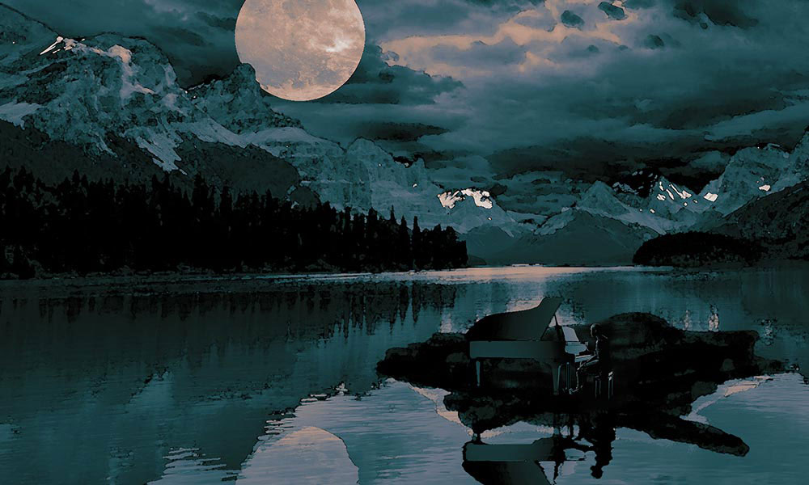
What are some example for that?
Claude Debussy – 'Clair de Lune’
Debussy - Clair de Lune - YouTube
Source: https://www.udiscovermusic.com/classical-features/debussy-clair-de-lune-masterpiece-guide/
Notes:
Claude Debussy is one of the earliest impressionist composers, the music is inspired by nature art and the orient
It is one of Debussy's earliest works, the music itself already so dreamy, I can draw a picture in my mind that the moonlight came through the window and streaming into the room, and has that feeling of midnight lying down on the bad and look at the moon through the window

Slide 5
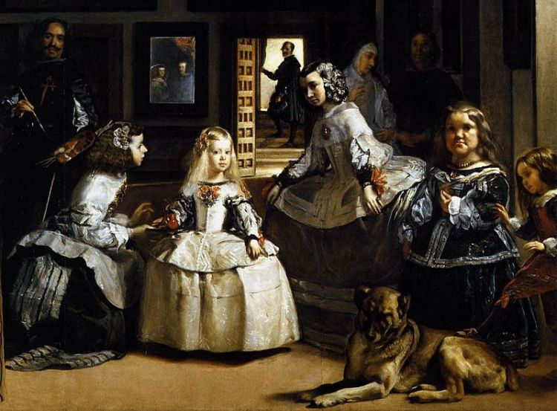
What are some example for that?
Maurice Ravel – Pavane for Dead Princess
Maurice Ravel - Pavane for Dead Princess - YouTube
Credit to: Velázquez (1599-1660)
Notes:
Story:
Ravel scribbled the piece for a commission in 1899, when he was 24
Ravel was at pains to point out that it 'Is not a funeral lament for a dead child, but rather an evocation of the pavane that might have been danced by such a little princess as painted by Velázquez’.
It is wistful daydream of something a sixteenth-century Spanish princess might have danced to, (A Wonder of a 16 century Spanish princess may have danced the pavane)
Pavane:
a stately court dance by couples that was introduced from southern Europe into England in the 16th century (Renaissance period)
music having the slow duple rhythm of a pavane

Slide 6
Conclusion
Mood and Atmosphere
Dreamy and moody sound
Some of the example:
  Claude Debussy – 'Prelude L'apres-midi D'un Faune'
  Maurice Ravel – 'Pavane Pour Une Infante Défunte'
  Claude Debussy – 'Nocturn'
  Manuel de Falla – 'Sieta Canciones Populares Españolas
  Claude Debussy – 'Clair de Lune'
  Maurice Ravel's "Boléro"
Notes:
What is Impressionist Music?
A style that are conveying Mood and Atmosphere
Why am I interested in Impressionist Music?
Attracted by their dreamy and moody sound, and imaginable melody
What are some example for that?
Check out the composer and tunes shown on the ppt

Slide 7
Thank you!

